Slide 1
RANJANA KANTI
ANIMATOR
DESIGNER
SOCIAL ACTIVIST

Slide 2
FEW CAUSES I HAVE WORKED FOR …
Free tuition to children of illiterate parents
Audio books for visually handicapped and helping riot affected people
Training and later help set up business for economically deprived housewives in stitching
Free training in Animation & Graphics to urban slum youth with placements in the industry
Assisted in setting up small scale business of spices, embroidery etc. for slum housewives
Awareness programs in slums regarding vaccination, hygiene,
Initiated vermin culture projects and garbage segregation.
Conducted campaigns for environment conservation

Slide 3



HOME
SOCIAL NETWORKING
SITES
MEETINGS

Slide 4

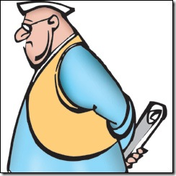


NGOs
POLITICIANS
ECONOMISTS

Slide 5
RIGHTS AND RESPONSIBILITIES
  Constitutional
  Civic
  Social
  Societal
  Environmental

Slide 6

INERTIA – THE ROOT CAUSE…

Slide 7


Slide 8
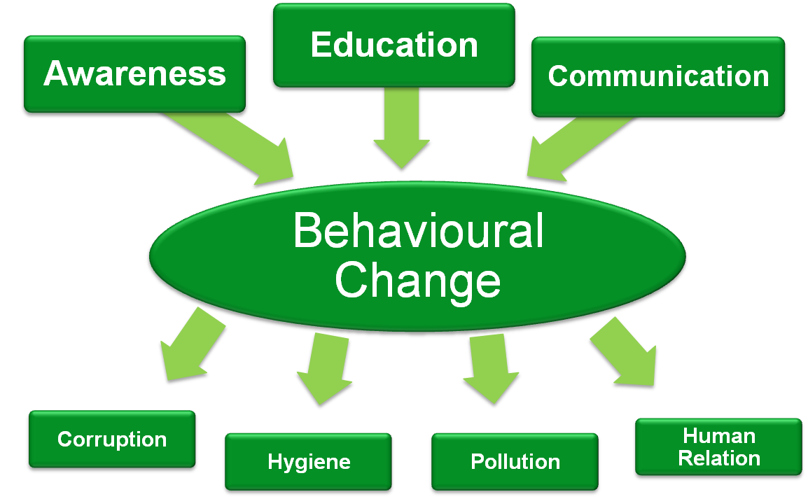
Notes:
SLIDE 16. - What we need For Social Change!
So how will this change occur?
Some broad NEEDS of India as the movement sees –
Awareness (Gaining knowledge),
Education (Processing knowledge) and
Communication (Spreading knowledge).
All NEEDS are complementary. What I mean by this is that it is not just enough to know the term 'Global Warming' but know the causes and consequences and spread that information by making others aware.
These NEEDS then with motivation and smaller activities bring out BEHAVIOURAL CHANGE in oneself.
If each of us have a behavioral change, we could solve problems like Corruption (Clean, Transparent & Good Governance), Hygiene (Good health and Sanitation), Pollution (Clean and Green Environment), and Human Relations (harmonious Relationship with each other and different communities).
We are just enablers of this behavioral change! We must target the root causes - even if it is going to take longer.
8

Slide 9
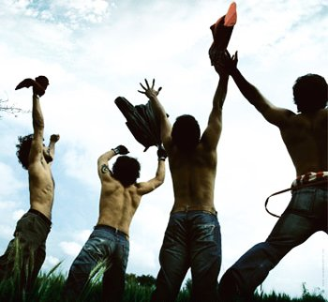
UNLOCK THE POTENTIAL…

Slide 10
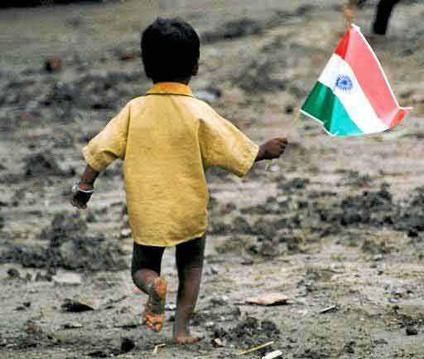
THINK AND ACT INDIAN…

Slide 11
VISION OF INDIA Redefined
HAPPY INDIA
Prosperous India
Green India
Healthy India
Clean India
Awaken India
Notes:
SLIDE 15. - My Wish List for Social Change – Stages of India Redefined
What are the changes you would want to bring out?
I am sure, everyone will have their list. Here is mine –
Call out next (for animated text)
AWAKEN INDIA – AWARENESS, EDUCATION & COMMUNICATION
Call out next (for animated text)
CLEAN INDIA – CORRUPTION, POLLUTION, HYGIENE, ENVIRONMENT, WATER (ANYTHING REQUIRING CLEANSING)
Call out next (for animated text)
HEALTHY INDIA – RESULT OF CLEAN INDIA+ SPECIFIC FOCUS ON HEALTH ISSUES
Call out next (for animated text)
GREEN INDIA – RESULT OF CLEAN INDIA + SUSTAINABLE METHODS OF GREENING OF INDIA
Call out next (for animated text)
PROSPEROUS INDIA – ABOVE INTIATIVES LEADING TO PROSPERITY ACROSS BOARD
Call out next (for animated text)
HAPPY INDIA – END RESULT OF ALL INITIATIVES (may be UTOPIAN), SOMETHING TO STRIVE FOR
11

Slide 12
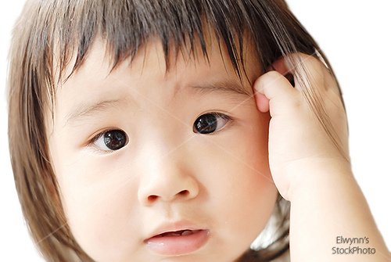
OK..BUT HOW?

Slide 13
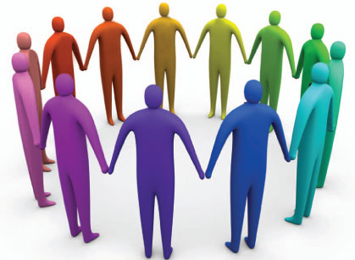
BRINGING THEM TOGETHER

Slide 14
HOW?
STRUCTURE
DESIRE TO
DO SOMETHING

Slide 15
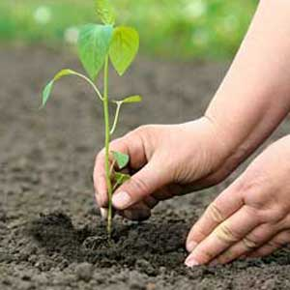

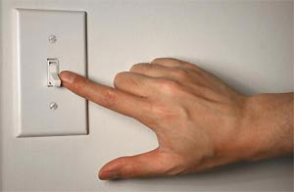
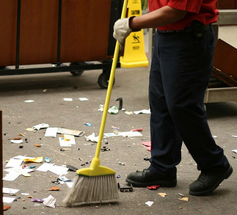
SIMPLE ACTIVITIES…
SPRADING
LITERACY
PLANTING
TREES
SAVING
ELECTRICITY
CLEANING UP

Slide 16
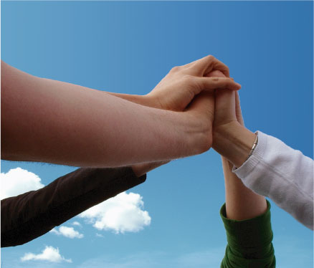
EMPOWERMENT

Slide 17
WHAT’S SO UNIQUE ABOUT THIS?

Slide 18
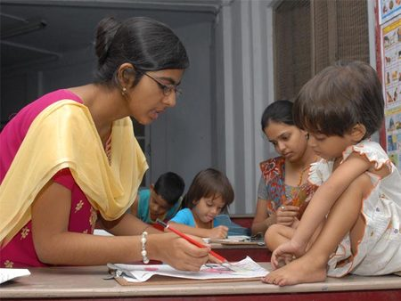
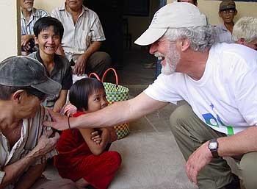

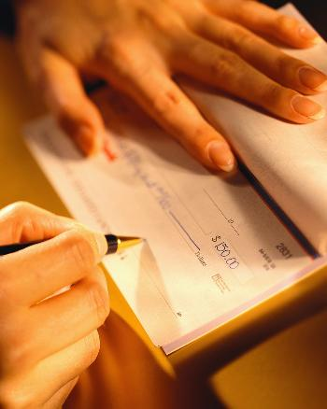
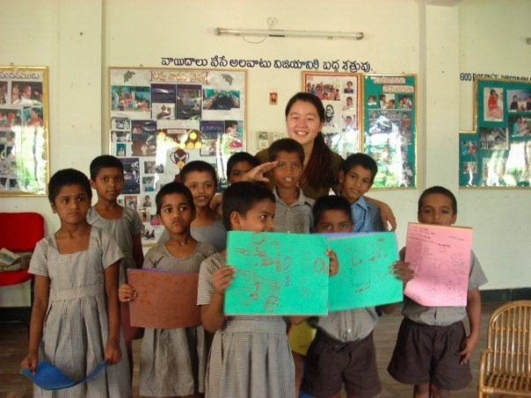
WONDERFUL WORKS…

Slide 19
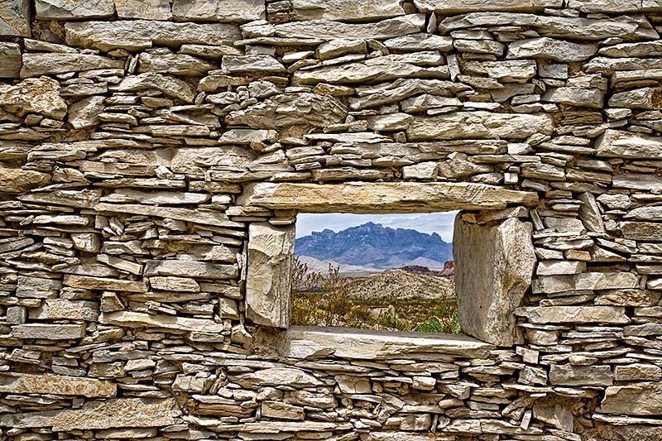
WITHIN A CONTEXT…

Slide 20
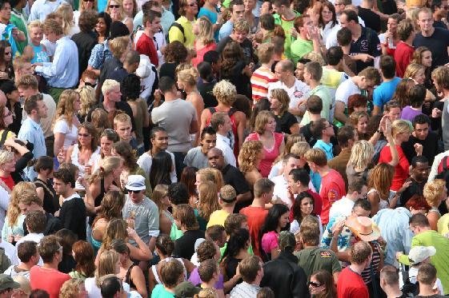
LOST…

Slide 21
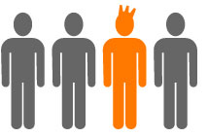
POTENIAL OF AN INDIVIDUAL

Slide 22
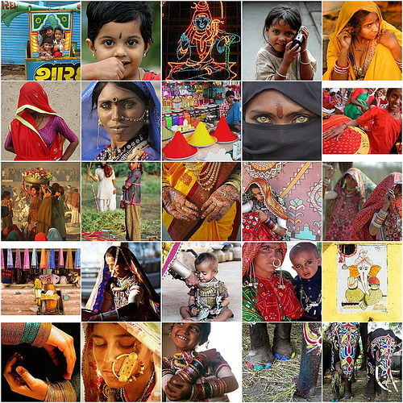
DIVERSITY…

Slide 23
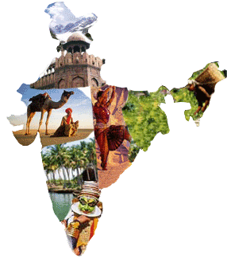
AMALGAMATION OF VISIONS…

Slide 24

WORK WITH ANY GROUP…

Slide 25

BRINGING TOGETHER DROPS…

Slide 26
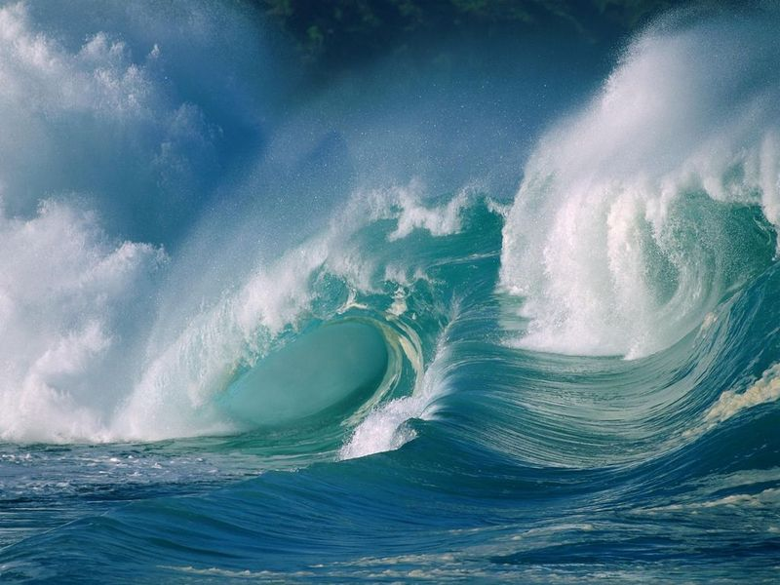
…TO CREATE AN OCEAN

Slide 27
WHERE IS
INDIA REDEFINED TODAY?

Slide 28
MEMBERSHIP
MORE THAN
1,00,000
JUST BY WORD OF MOUTH
AND
PASSING THE WEBSITE LINK

Slide 29
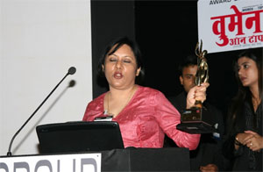
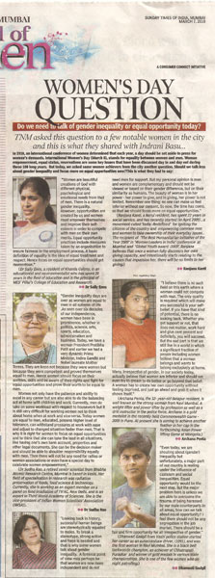
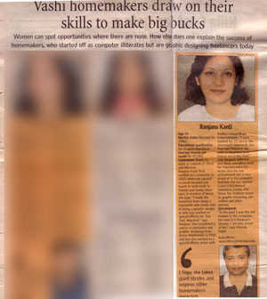
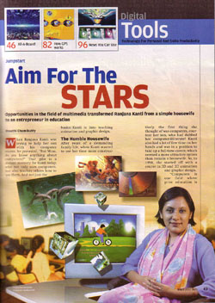
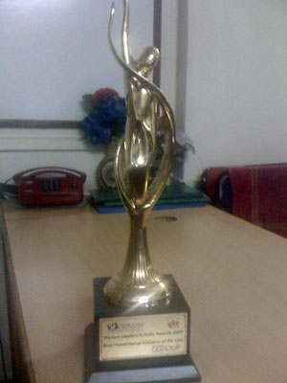
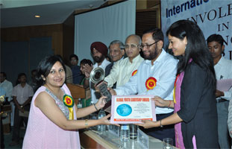
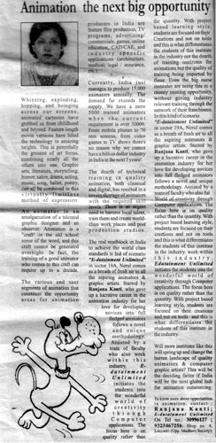
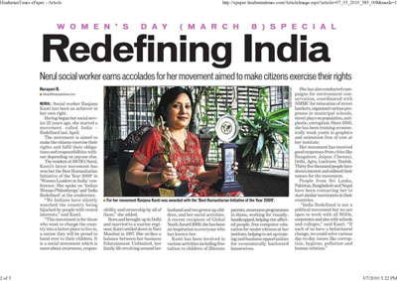
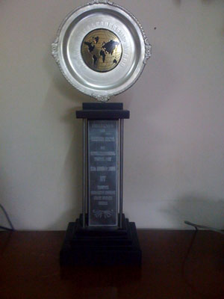
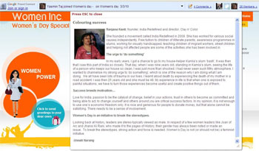
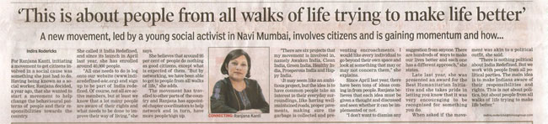
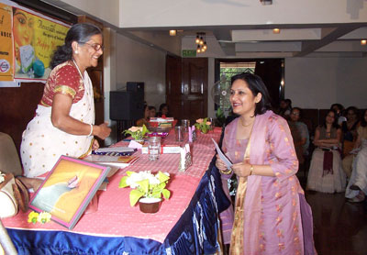
Notes:
29

Slide 30
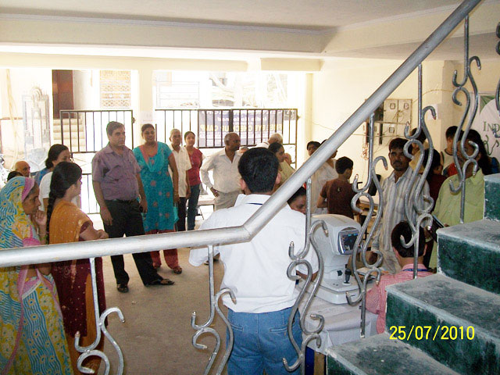


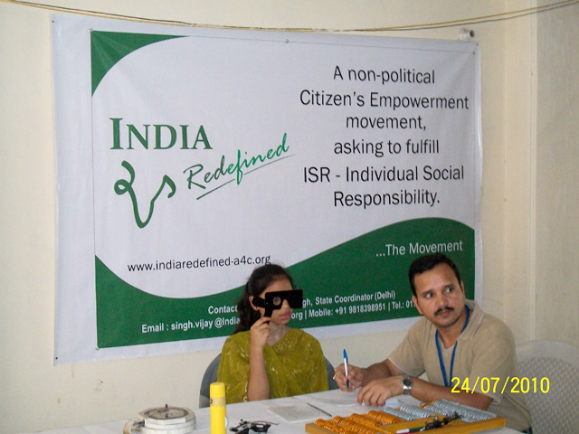
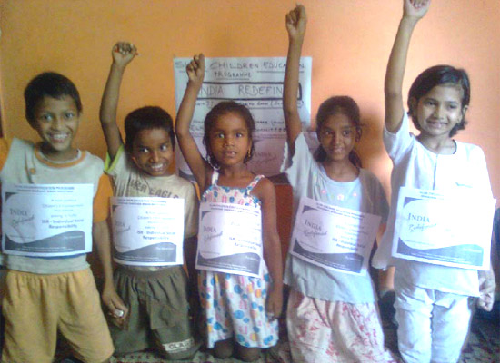
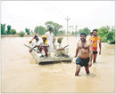
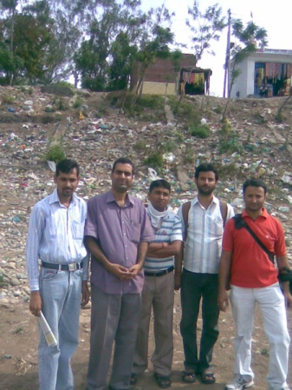
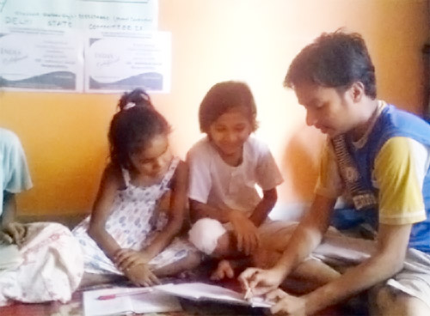
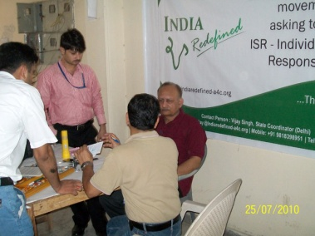
A FEW BABY STEPS…
Notes:
30

Slide 31

JOURNEY OF A THOUSAND MILES BEGINS WITH A SINGLE STEP
- CONFUCIUS

Slide 32

DONATION

Slide 33
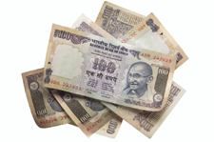
NOT OF MONEY…

Slide 34

…BUT TIME

Slide 35
THANK YOU

